Slide 1
Assessing Groundwater Extraction and Recharge Patterns In India
Tableau Project
A Comprehensive Analysis by City and State
Analyzed BY,
M.Senthil Kumar

Slide 2
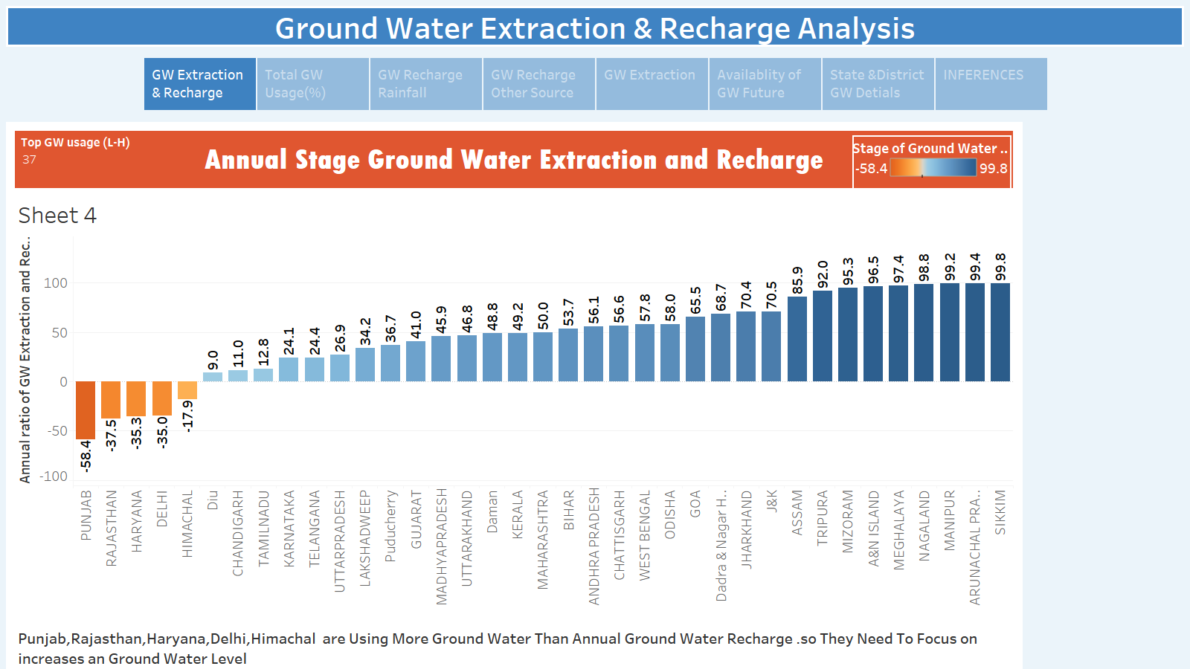

Slide 3
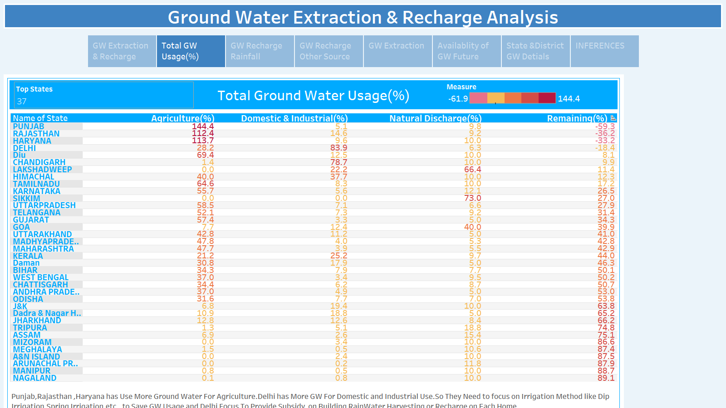

Slide 4
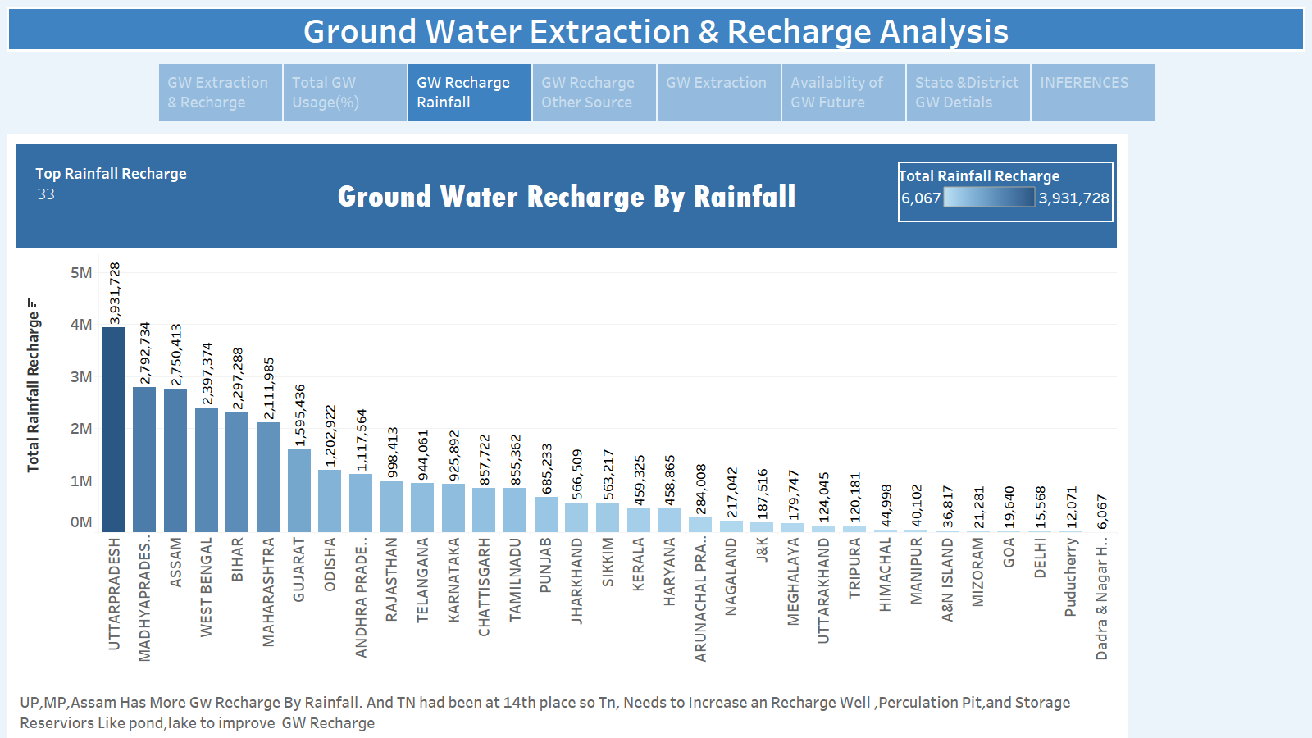

Slide 5
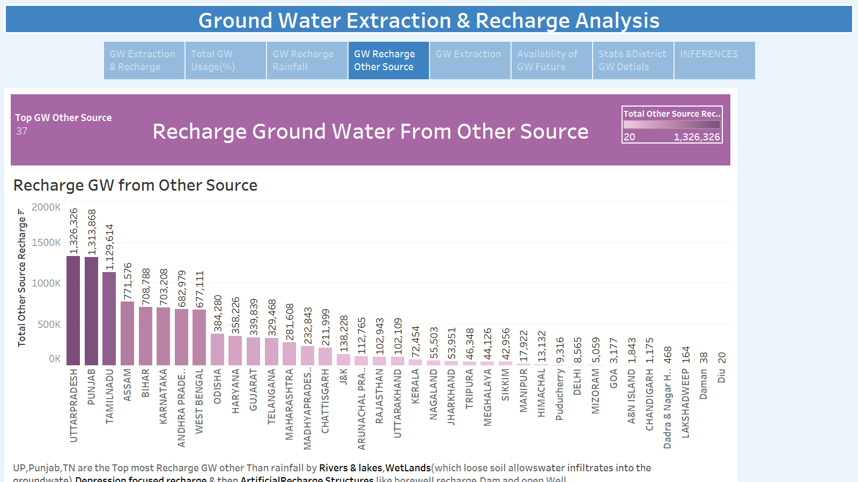

Slide 6
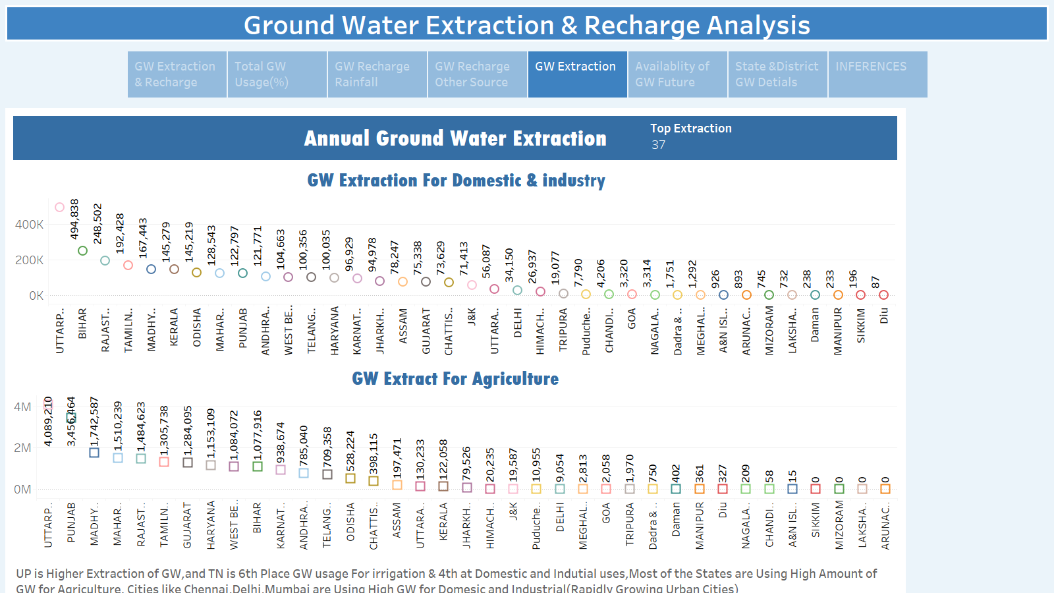

Slide 7
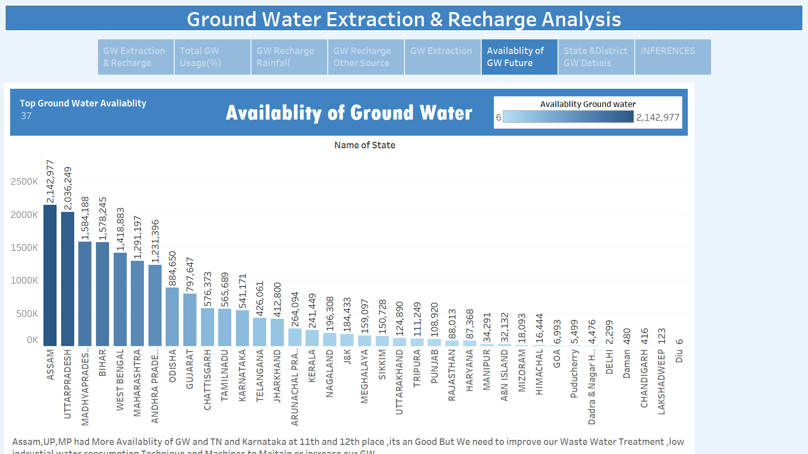

Slide 8
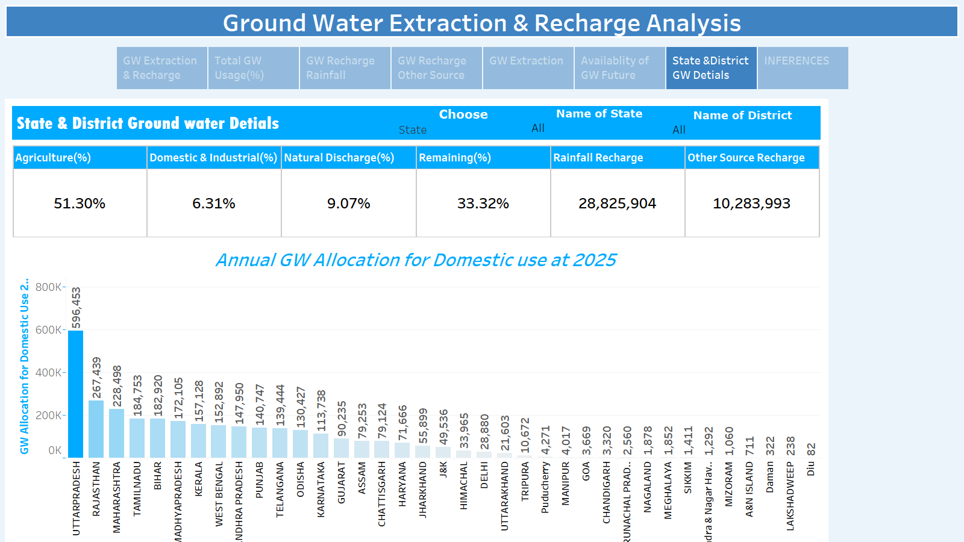

Slide 9
